Slide 1
International Scouting
A Brief Overview
Notes:
“First, it’s motivation to stay in Scouting as a youth,” he says. “And second, it’s motivation to come back to Scouting as an adult.”
But there’s another vital reason, too. Besides being an educational initiative, international Scouting also is a peace initiative, and peace is a prime goal expressed by the World Organization of the Scout Movement.
Riding on flights home from world jamborees, Bob Russell has asked Scouts what they’ve learned from the experience. One said, “If I had a friend from another country, it would be really hard to go to war with that country.”
“All of a sudden,” Russell says, “they have a different perspective, a different worldview.”

Slide 2
Notes:
World Scout Emblem -- In the US, we call it the World Crest. UK World Membership Badge… joining award.
The BSA first used the badge as an award for Scouts and Scouters who participated in an international Scouting event from early 1956 through 1991; requirements were devised by each council. In 1991, the BSA made it part of the uniform.
It denotes we are members of the World Wide Brotherhood of Scouting.
Permanent
The BSA donates a small portion of the proceeds from each patch sold to the World Scout Foundation to assist with the development of Scouting's emerging nations.

Slide 3
World Organization of the Scout Movement
“WOSM”
Notes:
Not to be confused with WAGGGS - World Association of Girl Guides and Girl Scouts
(nearly as large as WOSM)
MISSION:
To contribute to the education of young people, through a value system based on the Scout Promise and Scout Law, to help build a better world where people are self-fulfilled as individuals and play a constructive role in society.
Established in 1922
Offices moved from Geneva, Switzerland to Kuala Lumpur, Malaysia
Triennial World Scout Conference
Youth Forum
World Scout Committee
NGO – with ties to UN
Regional Offices
Africa Nairobi, Kenya
Arab Cairo, Egypt
Asia-Pacific Makati, Philippines
Eurasia Kiev, Ukraine
European Bruxelles, Belgium
Interamerican Panama City, Panama

Slide 4
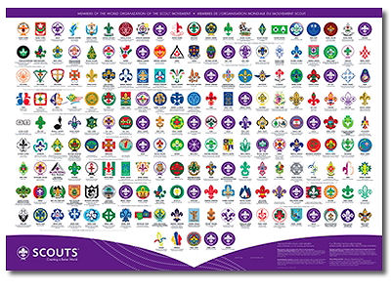
WOSM
Notes:
38 Million Scouts & Guides
The largest association is Indonesia with 8 million members
The BSA is second in size
161 Countries
5 Countries without Scouting
Andorra - Scouting in Andorra
Cuba - Cuban Scouting prior to 1961 and in exile
Laos - Laotian Scouting prior to 1975 and in exile
North Korea - shared history with Korea Scout Association prior to 1950
Vatican City - Scouting in Vatican City

Slide 5
World Friendship Fund
Notes:
Collections –where does money go?!?
The World Friendship Fund was developed during the closing days of World War II. At that time, there was a great need to rebuild Scouting in those nations that had been wracked by war and were just emerging from the shadows of totalitarianism
• Providing support to help create the first Scout camp and environmental center in Madagascar
• Providing funding for the sanitation needs of the National Scout Center in Bhutan
• Providing funding for a bus for the Scouts of Nepal to get to their camp
• Supporting the building of the Scout house in Mongolia
• Providing support of the Ecological Youth Center field project in Panama
• Providing support to the Asian Pacific region after the tsunami
• Providing supplies and relief to Haiti after a devastating earthquake
GET YOUR CERTIFICATE!

Slide 6
Scout Centres
Kandersteg - Switzerland
Suncheon – South Korea
Cairo – Egypt
Picarquín – Chile
Notes:
RECOGNIZED…. (not run by)
Maybe not Suncheon?

Slide 7
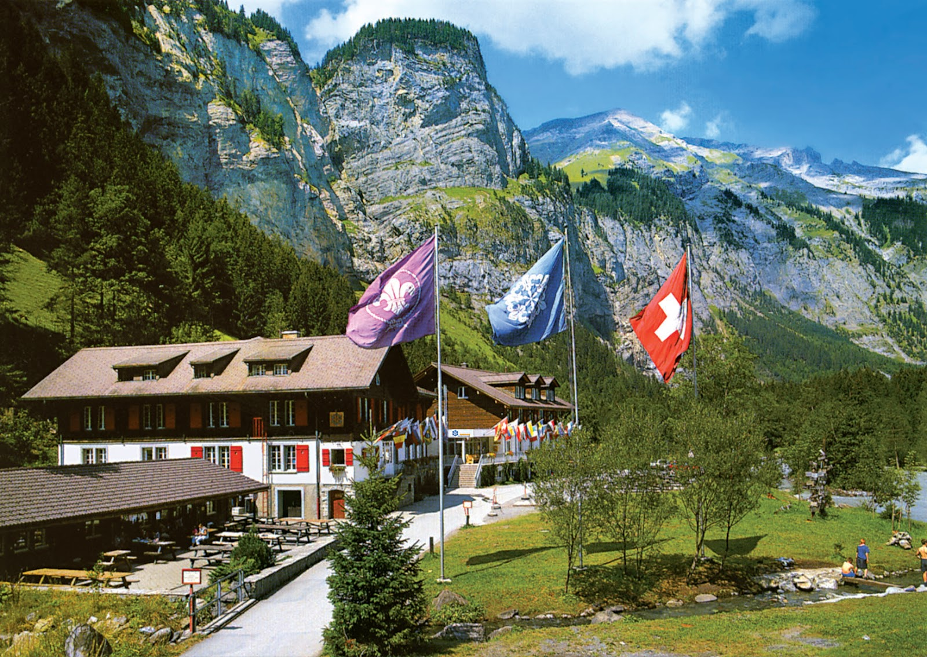

Slide 9
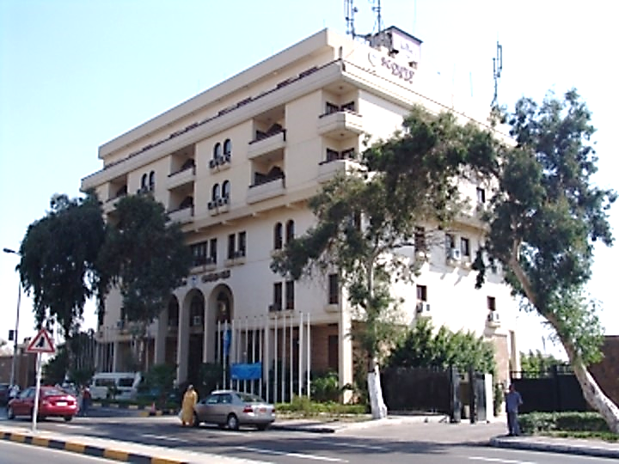

Slide 10
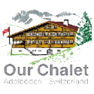
Additional Scout Centres

Slide 11
International Staff
Kandersteg
Suncheon
European
CHEAP INTERNATIONAL TRAVEL!!!!
Notes:
50% - European
4 months
8 Countries
Friends forever
About 30 European
Including Gilwell
WHY?
World smaller
Those who understand and appreciate int’l
Forms, letters, ILOI - How To
International Letter of Introduction
International Driving Permit
Learn Customs
Uniform part vs. Patches
Connect before leaving
Be Prepared
PLAN

Slide 12
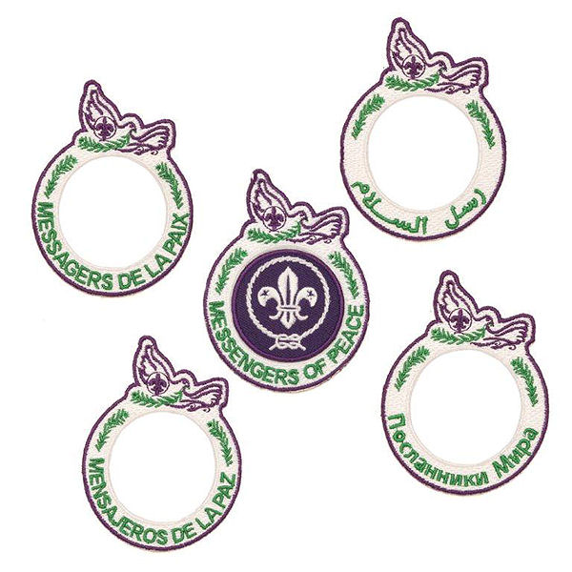
World Peace
Notes:
Scouting founder Robert Baden-Powell called on participants to carry the spirit of the jamboree home “so that we may help to develop peace and happiness in the world and goodwill among all Scouts.
Scouts who complete MOP projects will be eligible for a special recognition: a ring patch that goes around the World Crest. That patch will symbolize their participation in an ever-widening circle of Scouts who are not just visualizing world peace but are helping to make it a reality.

Slide 13
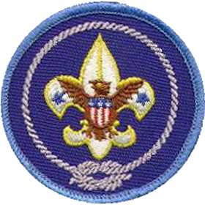
International Spirit Award
Notes:
YOUTH & ADULTS
The award seeks to broaden knowledge of international Scouting and increase appreciation and awareness of different cultures and countries.

Slide 14
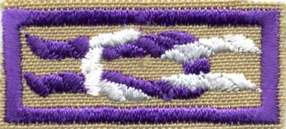
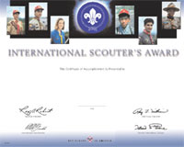
International Scouter Award
Notes:
ADULTS
The International Scouter's Award encourages Scouters to broaden their involvement in Scouting through participation in world Scouting activities and recognizes Scouters for their contributions to world Scouting.
Giving leadership to international Scouting:
Serve as a council international representative for a minimum of two consecutive years.
Serve as a council international committee member or as a member of the BSA's International Committee for a minimum of three consecutive years.
Serve as a registered adult leader with a Direct Service, Far East Council, or Transatlantic Council Cub Scout pack, Boy Scout troop, or Venturing crew.
Giving leadership to international events held in the United States:
Host Scouts/Scouters (minimum of three visitors per group) from another country as part of an official national, council, district, or unit activity.
Serve on the international staff at a national Scout jamboree.
Assist in the International Camp Staff program. Be responsible for bringing a foreign Scout on staff to the council's summer camp program for two summer camp seasons.
Giving leadership to international events held in other countries:
Serve as an adult leader in a BSA contingent to a world Scout jamboree or Pan-American Scout jamboree.
Serve as an adult leader for a group of BSA Scouts participating in an event held by a foreign Scout association recognized by the World Organization of the Scout Movement. The activity may be an exchange program, camp experience, a tour activity, or a home hospitality function.
Serve on the international service staff of a world Scout jamboree.
Educating self and others:
Attend an international Scout conference at the Philmont Training Center. Share what you have learned with others in your council.
Promote international Scouting at a district, council, region, or national event.
Participate in organizing or providing leadership for a BSA Scout activity in another country that involves interaction with Scouts from that country, such as an exchange program, camping experience, or tour activity.
Giving support to international Scouting:
Organize a collection for the World Friendship Fund at two district and/or council events.
Become or recruit a member of the Order of the Condor for the Interamerican Scout Foundation.
Become or recruit a Baden-Powell Fellow for the World Scout Foundation.

Slide 15
World Conservation Award
Notes:
The World Conservation Award is issued by many of the national Scout associations affiliated to the World Organization of the Scout Movement, and was created in conjunction with the World Wide Fund for Nature, partially in response to the rise in popularity of Green Scouting, at some time prior to 1977. Different countries have set different standards or criteria in order for Scouts to receive this award.
Cub Scouting: The requirements differ by rank, but Cub Scouts at all levels must learn about nature and participate in a den or pack conservation project. Webelos Scouts must earn the Forester, Naturalist, and Outdoorsman activity badges and take part in a den or pack conservation project. The Cub Scout World Conservation Award uses the panda emblem on a gold background with a blue border.
Boy Scouting: by earning the Environmental Science merit badge, either Soil and Water Conservation or Fish and Wildlife Management merit badge, and Citizenship in the World merit badge. The Boy Scout World Conservation Award uses the panda emblem on a tan background with a tan border.^{[2]}
Venturing: by earning the Ecology elective of the Ranger Award and by showing and teaching about environmental relationships. The Venturing World Conservation Award uses the panda emblem on a yellow background with a green border.

Slide 16
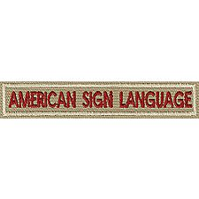
Interpreter Strip
Notes:
must be able to carry on a conversation in a foreign language or in sign language, write a letter in the foreign language (not required for signing), and translate orally and in writing from one language to another

Slide 17
JOTA/JOTI
Jamboree on the Internet
Jamboree on the Air
Notes:
Little John in Nottingham Forest
Loaner radios
Ham organizations

Slide 18
Unit Program Ideas
World brotherhood night
Exchange (Scout) student speaker
Host international camp staff visitor
Foods from family heritage
Messenger of Peace project
JOTA/JOTI
Notes:
Partner with Rotary Club!

Slide 19
On the Web
www.Scouting.org/international

Slide 20
Local Events
Michigan International Campree
Notes:
Michigan every 4 years – next on in 2016
Brits come to CSM every 2 or 4 years?

Slide 21
Local Events
Scouts from Britian at CSM!
Notes:
Michigan every 4 years – next on in 2016
Brits come to CSM every 2 or 4 years?

Slide 22
BSA Contingent
Notes:
US is Invited to many events!!!
Must be nominated by Council IHR

Slide 23
World Moot
Notes:
Get’s about 2-3000 participants
Older Scouts
Not well supported by US
Last on in Canada, Next one in Iceland
Drinking
Sex
Smoking

Slide 24
World Scout Jamboree
World Jamboree
Notes:
CUB SCOUTS NOW…
2019 – wsj
Co hosted – Canada & Mexico

Slide 25
World Scout Jamboree
The Summit ~ July-August 2019
Notes:
#24 NOT ALL US WHO APPLY GET TO GO!!
$100 to person who can tell where #25 (2023) is going to be… Brazil, Poland, South Korea

Slide 26
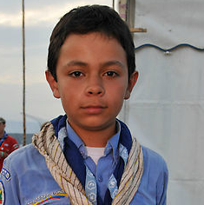
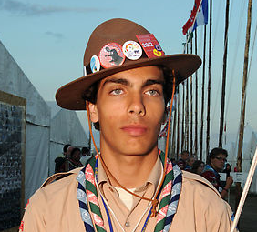
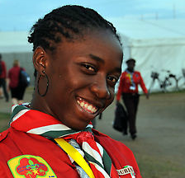
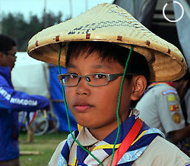
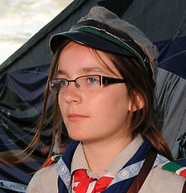
World Scout Jamboree
Notes:
Every 4 years
#23 – in Japan
World Scout Jamboree
Kirarahama, Japan ~ July 28 - Aug 8, 2015

Slide 27
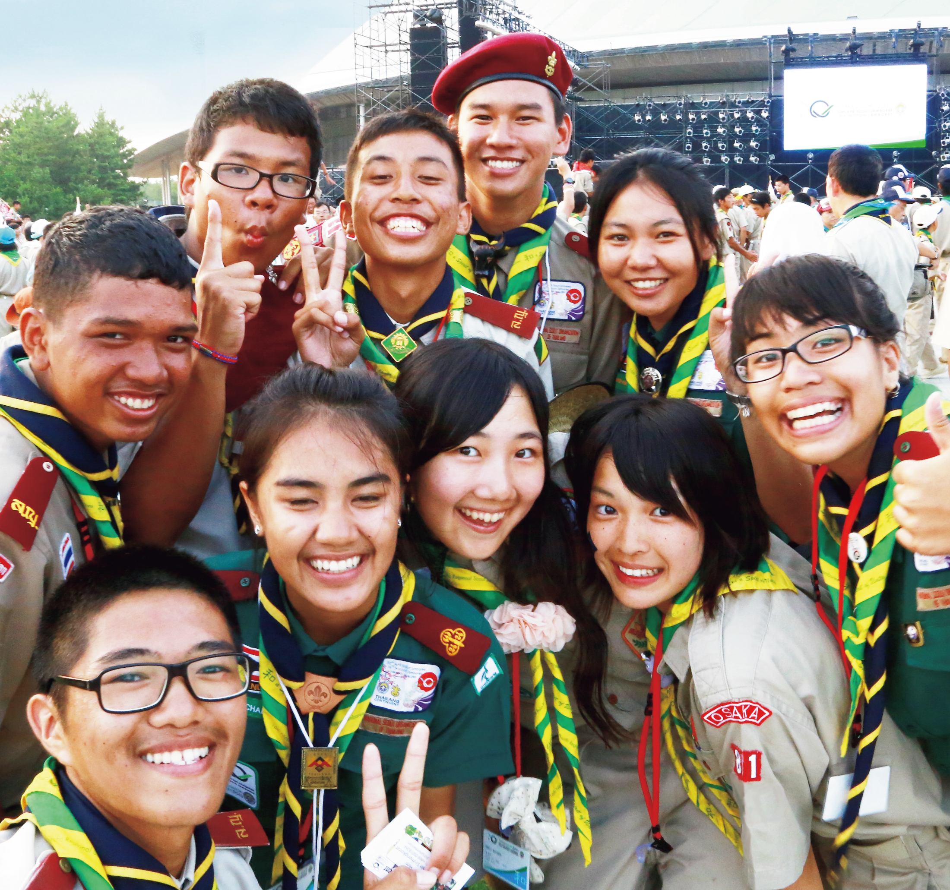
World Scout Jamboree
Notes:
Every 4 years
#24 – in Japan
World Scout Jamboree
Kirarahama, Japan ~ July 28 - Aug 8, 2015

Slide 28
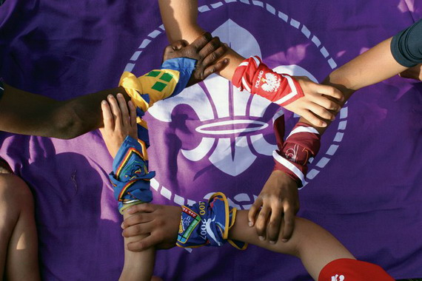

Slide 29
Association of Top Achiever Scouts
Notes:
ATAS was formed in 2004 as a loose fraternity to unite all leaders who were once top achievers when they were youth members together so as to encourage them to assist and promote the aspiration of their youth members in their own NSOs to achieve the same level of success.
It proves to be very popular and through mostly the hardworks of Simon Rhee #002 it spreaded and grows quickly from an APR outfit of old boys networks of a few APR Committee and related members to a World Wide body of 3,000 members.
Alexander Wong- China –
IA095

